Slide 1


Progress
Which pathways are affected by induction with methyl-jasmonate and ethylene?
The Periwinkles

Slide 2
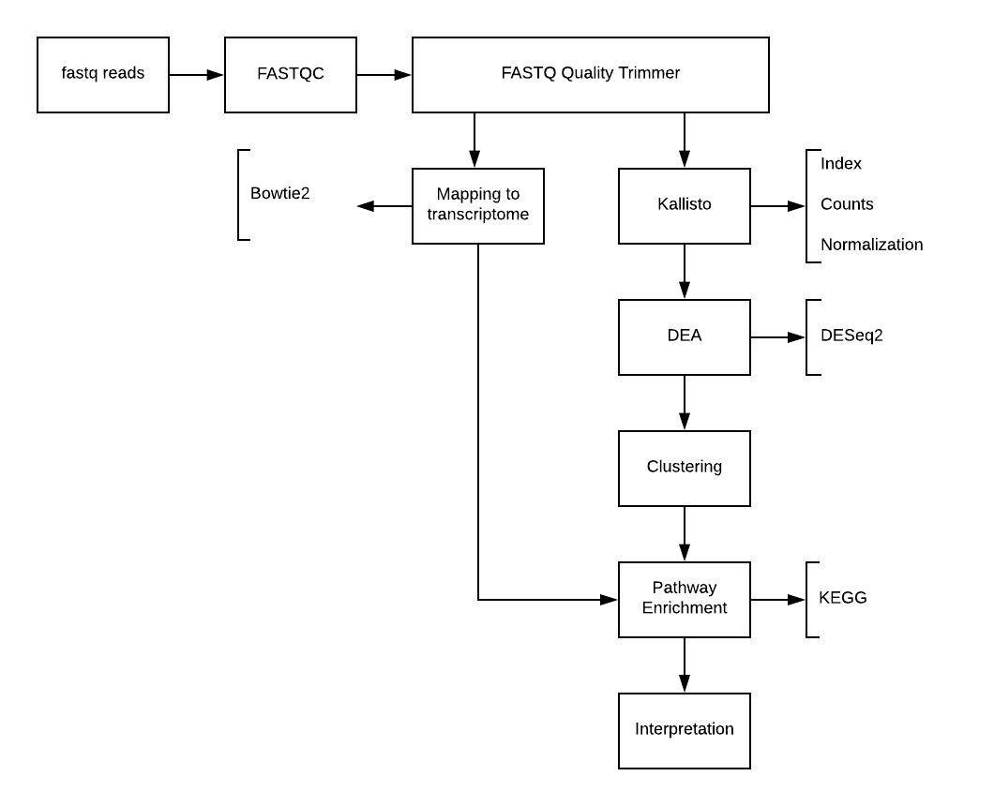

Project flow

Slide 3


Data
From Pan et al. (2018):
Catharanthus roseus seedlings, control, 3 replicates
Catharanthus roseus seedlings, methyl jasmonate treatment, 3 replicates
Catharanthus roseus seedlings, ethylene treatment, 3 replicates Only forward reads!
De novo transcriptome FASTA from paper
After bad mapping results (mapping rate: 17-20% )
Same forward reads
Transcriptome from Franke et al. (2018) (mapping rate: ~75% )

Slide 4
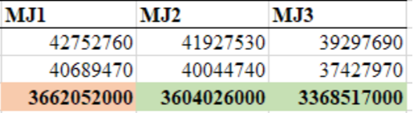
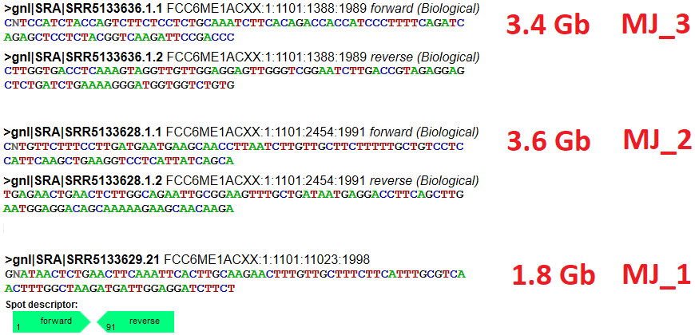
Anomaly
SRA

Slide 5
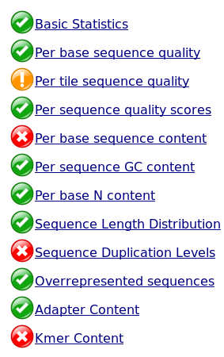
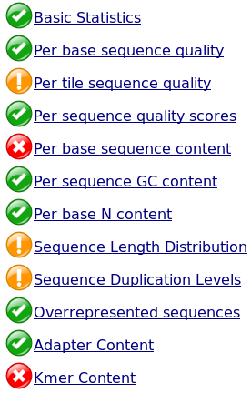
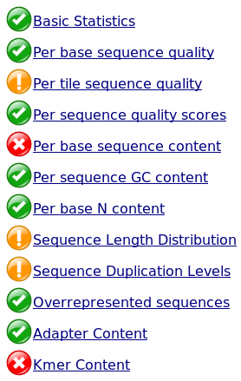
Quality control results
Example: SRR5133630_1
Untrimmed Trimmed -t 36 Trimmed -t 33

Slide 6


Mapping to transcriptome
Pan et al. transcriptome:
Bowtie2 / Hisat2
Various sensitivities
17-20%
Biased transcriptome?
Franke et al transcriptome:
Bowtie2
Default
79+%
In line with Kallisto

Slide 7
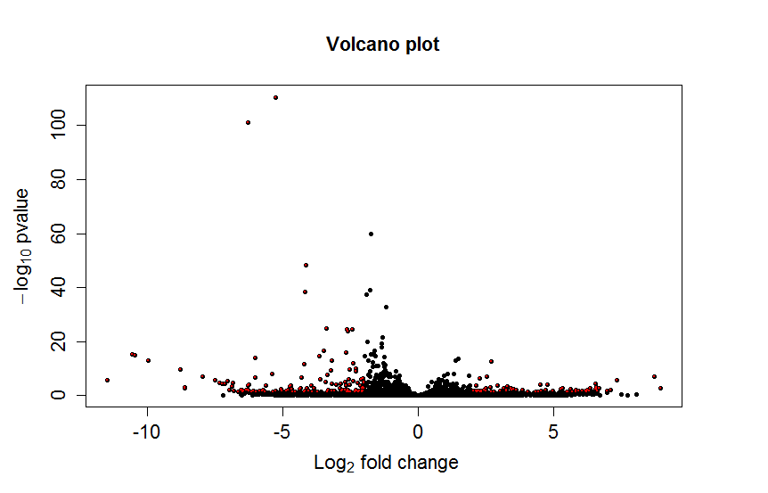
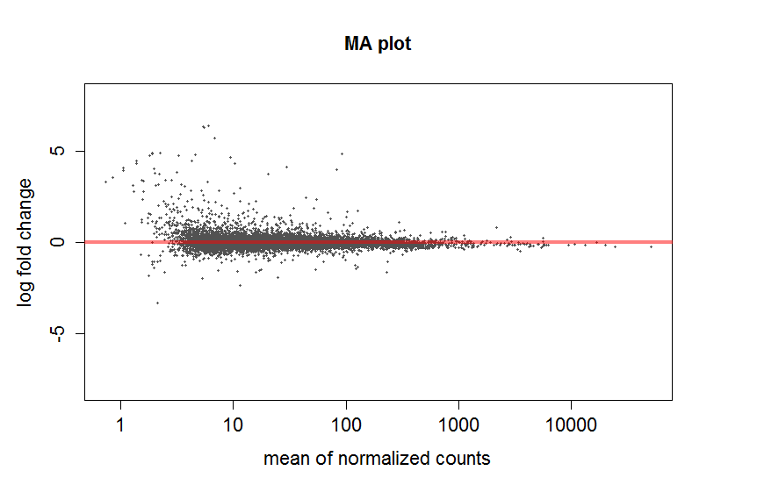
Differential Expression Analysis (DESeq2)
Volcano plot MA plot
significant
Notes:
Volcano:
Plots significance vs fold change
MA:
Each point in an MA plot represents a gene. The x-coordinate corresponds to the mean expression of the gene, and the y-axis corresponds to the log2 fold change between the two conditions/tissues. All red points correspond to genes with that are differentially expressed according to the adjusted p-value threshold (alpha) of 0.01.
Shrinks high change with low normalized counts.

Slide 8
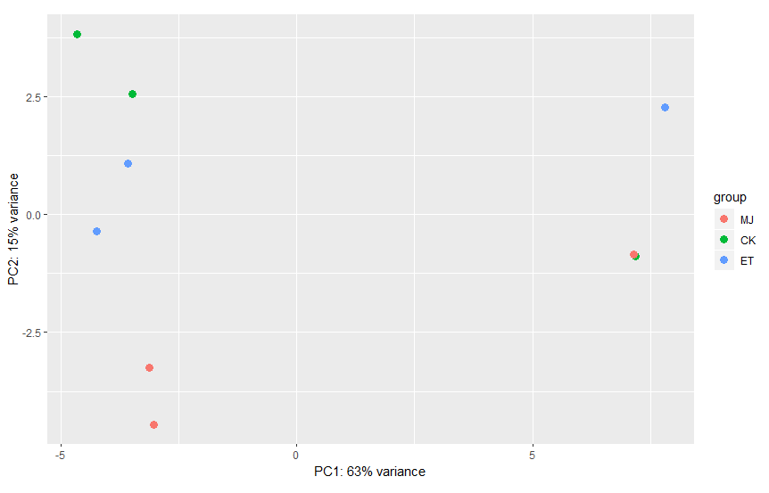
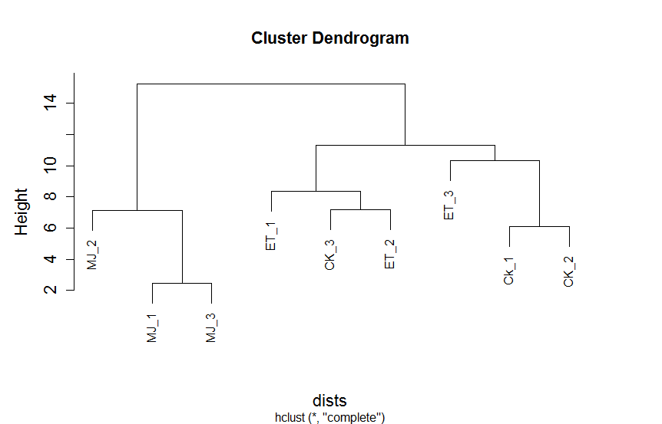
Cluster analysis
?
?
PC2
PC1

Slide 9
Steps ahead
Identify “outliers”
Triplets → Duplets?
DESeq2 → Sleuth?
Pathway enrichment analysis
Data interpretation
Research question

